Slide 1

Zepto Inventory Analysis
Business Insights from SQL-Based Inventory Data
By: Pragati Goel
June 2025

Slide 2

Project Overview
Analysed Zepto’s inventory dataset using SQL
Focused on product pricing, discounts, availability
Tools Used: PostgreSQL, SQL queries, PowerPoint
Dataset of 3,700+ products with 9+ attributes
Goal: Deliver business insights for stock and pricing decisions

Slide 3

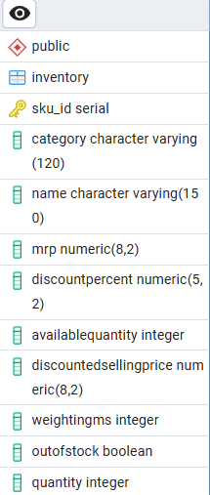
Inventory Database Schema
The dataset consists of a single primary table: Inventory
Each row represents a product listing with pricing, category, and stock information
Key Columns:
Sku_ID
Category, Name
MRP, DiscountPercent, DiscountedSellingPrice
AvailableQuantity, WeightInGms, Quantity
OutOfStock

Slide 4

Data Cleaning & Preparation
Converted price columns from paisa to rupees for consistency.
Removed/handled zero-priced records where pricing data was missing or invalid.
Filtered out duplicate product entries to avoid inflated insights.
Ensured availability columns (availableQuantity, outOfStock, quantity) were correctly interpreted.
Verified weights and quantity data to identify unrealistic or zero values.
Final cleaned dataset had ~3,700 records across 14 categories.
Update Inventory
Set mrp = mrp / 100.0
Where mrp Is Not Null;
Delete From Inventory
Where mrp Is Null Or mrp
= 0;

Slide 5

Q1: Out Of Stock Products
Key Questions Addressed:
How many products are currently out of stock?
Which categories have the most out-of-stock items?
Total Out-Of-Stock Products: 453
Top 3 Affected Categories:
Munchies - 64
Cooking Essentials - 64
Ice Cream & Desserts – 45
These three account for ~38% of out-of-stock items
Business Insight : High stockouts in munchies and cooking essentials suggest demand-supply mismatch. Review restocking strategy for fast-moving categories.

Slide 6





Q2 : Total Inventory Value by Category
Key Questions Addressed:
Which categories contribute the most to total inventory value?
Are high value categories aligned with priority restocking?
Top 3 Categories by Value:
Cooking Essentials – ₹2.9 Lakhs
Paan Corner – ₹2.3 Lakhs
Chocolates & Candies – ₹2.1 Lakhs
These three contribute to ~73% of total inventory value.
Business Insight – Focus on better forecasting and pricing strategy for high-value categories like Cooking Essentials & Paan Corner to optimize revenue and stock turnover.

Slide 7

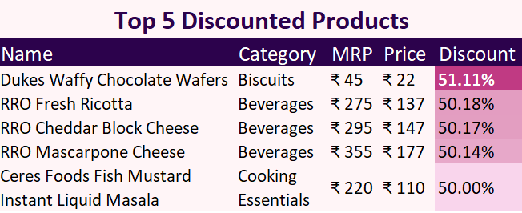
Q3: Highest Discounted Products
Key Questions Addressed:
Which products are being offered at the highest discount?
Are any patterns visible across categories?
Top 5 Discounted Products:
Dukes Waffy Chocolate Wafers
RRO Fresh Ricotta
RRO Cheddar Block Cheese
RRO Mascarpone Cheese
Ceres Foods Fish Mustard Instant Liquid Masala
Business Insight: Popular Essentials like Dukes Waffy Chocolate Wafers & RRO Fresh Ricotta are being heavily discounted. It’s important to analyse whether these substantial discounts are boosting sales margin or significantly impacting profit margins.

Slide 8
Q4: Logical Conflict in Stock Status
Key Questions Addressed:
Are there any mismatches between stock status and actual quantity?
How many such logical inconsistencies exist?
Results:
No conflicting records found between outOfStock status and availableQuantity
Data appears clean and consistent with no logical mismatches
Data Quality Insight: The system shows no mismatches between stock status and available quantity. This indicates clean data labeling and reliable inventory tracking – a positive sign for operational accuracy.
Select *
From Inventory
Where (outOfStock = TRUE
And
availableQuantity > 0)
Or (outOfStock = FALSE
And
availableQuantity = 0);

Slide 9
Q5: Grams per Rupee Value
Key Questions Addressed:
Which products provide the most quantity per rupee spent?
Are there any anomalies in grams-per-rupee value?
Top 5 Products (Grams Per Rupee):
Vicks Cough Drops Menthol - 58
Onion – 52.63
Aashirvaad Iodised Salt – 52.63
Tata Salt – 41.67
Shubh kart - Nirmal sugandhi mogra wet dhoop zipper 20 sticks – 41.43
Business Insight: Products like Vicks Cough Drops, Onion, and Aashirvaad Salt offer high grams per rupee, making them strong value buys. Highlighting such items can boost customer trust and encourage repeat purchases.

Slide 10
Q6: Average Price and Discount by Category
Key Questions Addressed:
Which categories have the highest average selling price?
Are higher-priced categories offering larger discounts on average?
Is there a mismatch between high pricing and deep discounts?
Business Insight: Paan Corner, and Meats, Fish & Eggs show the highest average prices but Fruits & Vegetables have the deepest discounts despite being the lowest priced. This may reflect perishability or price sensitivity. Home cleaning maintains stable pricing with minimal discounts, indicating consistent consumer demand.
🔷 Price🔹Discount %

Slide 11



Final Insights / Summary
Inventory Challenges:
453 products are currently out of stock.
Munchies and Cooking Essentials show the highest stockouts, indicating a demand-supply mismatch.
Inventory Value Concentration:
Top 3 categories (Cooking Essentials, Paan Corner, Chocolates) contribute ~73% of inventory value.
These should be priority focus areas for inventory forecasting and pricing strategy.
Discounting Patterns:
Deep discounts observed in Beverages and Biscuits.
Important to assess whether this improves sales volume or reduces profit margins.
Pricing and Value:
No mismatch in stock-status and quantity.
High grams-per-rupee value in essentials like Onion and Vicks Cough Drops suggests strong value perception.
Data Quality:
No inconsistencies found in stock-status logic – indicating robust backend inventory processes.

